Slide 1
Game Prototype
-- Fruit Fall Frenzy
Comprehensive Development Project
Ariel Zhao Liu
GEX - Sr. Winter 2025

Slide 2
Game Overview
01

Slide 3
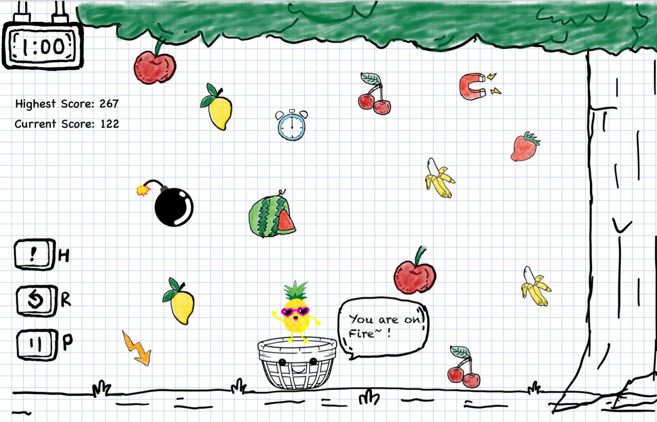
Game Overview - Fruit Fall Frenzy
Concept: A magical fruit tree is under attack by mischievous spirits. Players must protect the tree by catching falling fruits to score points and avoid bombs that reduce lives. The gameplay becomes progressively challenging with increasing fruit and bomb speeds.
Assets: By personally hand drawn. Some of artwork is based on images I studied online but was redrawn by hand. Using iPad + iPencil, Notability, Photoshop.

Slide 4
Gameplay
02

Slide 5
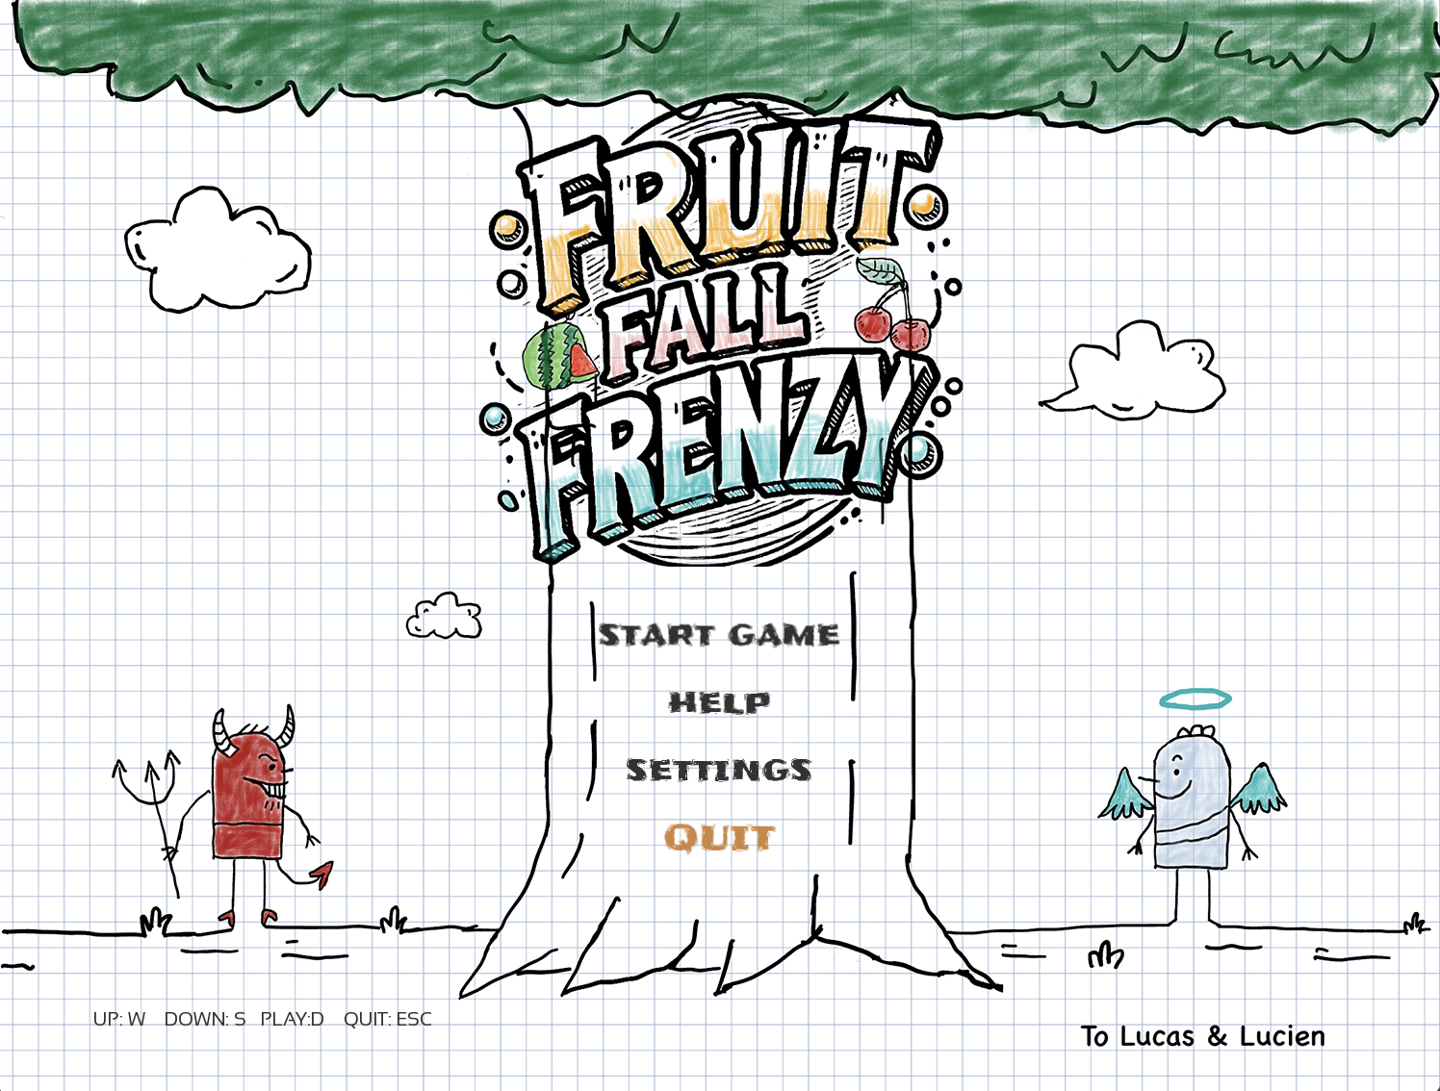
Main Menu

Slide 6
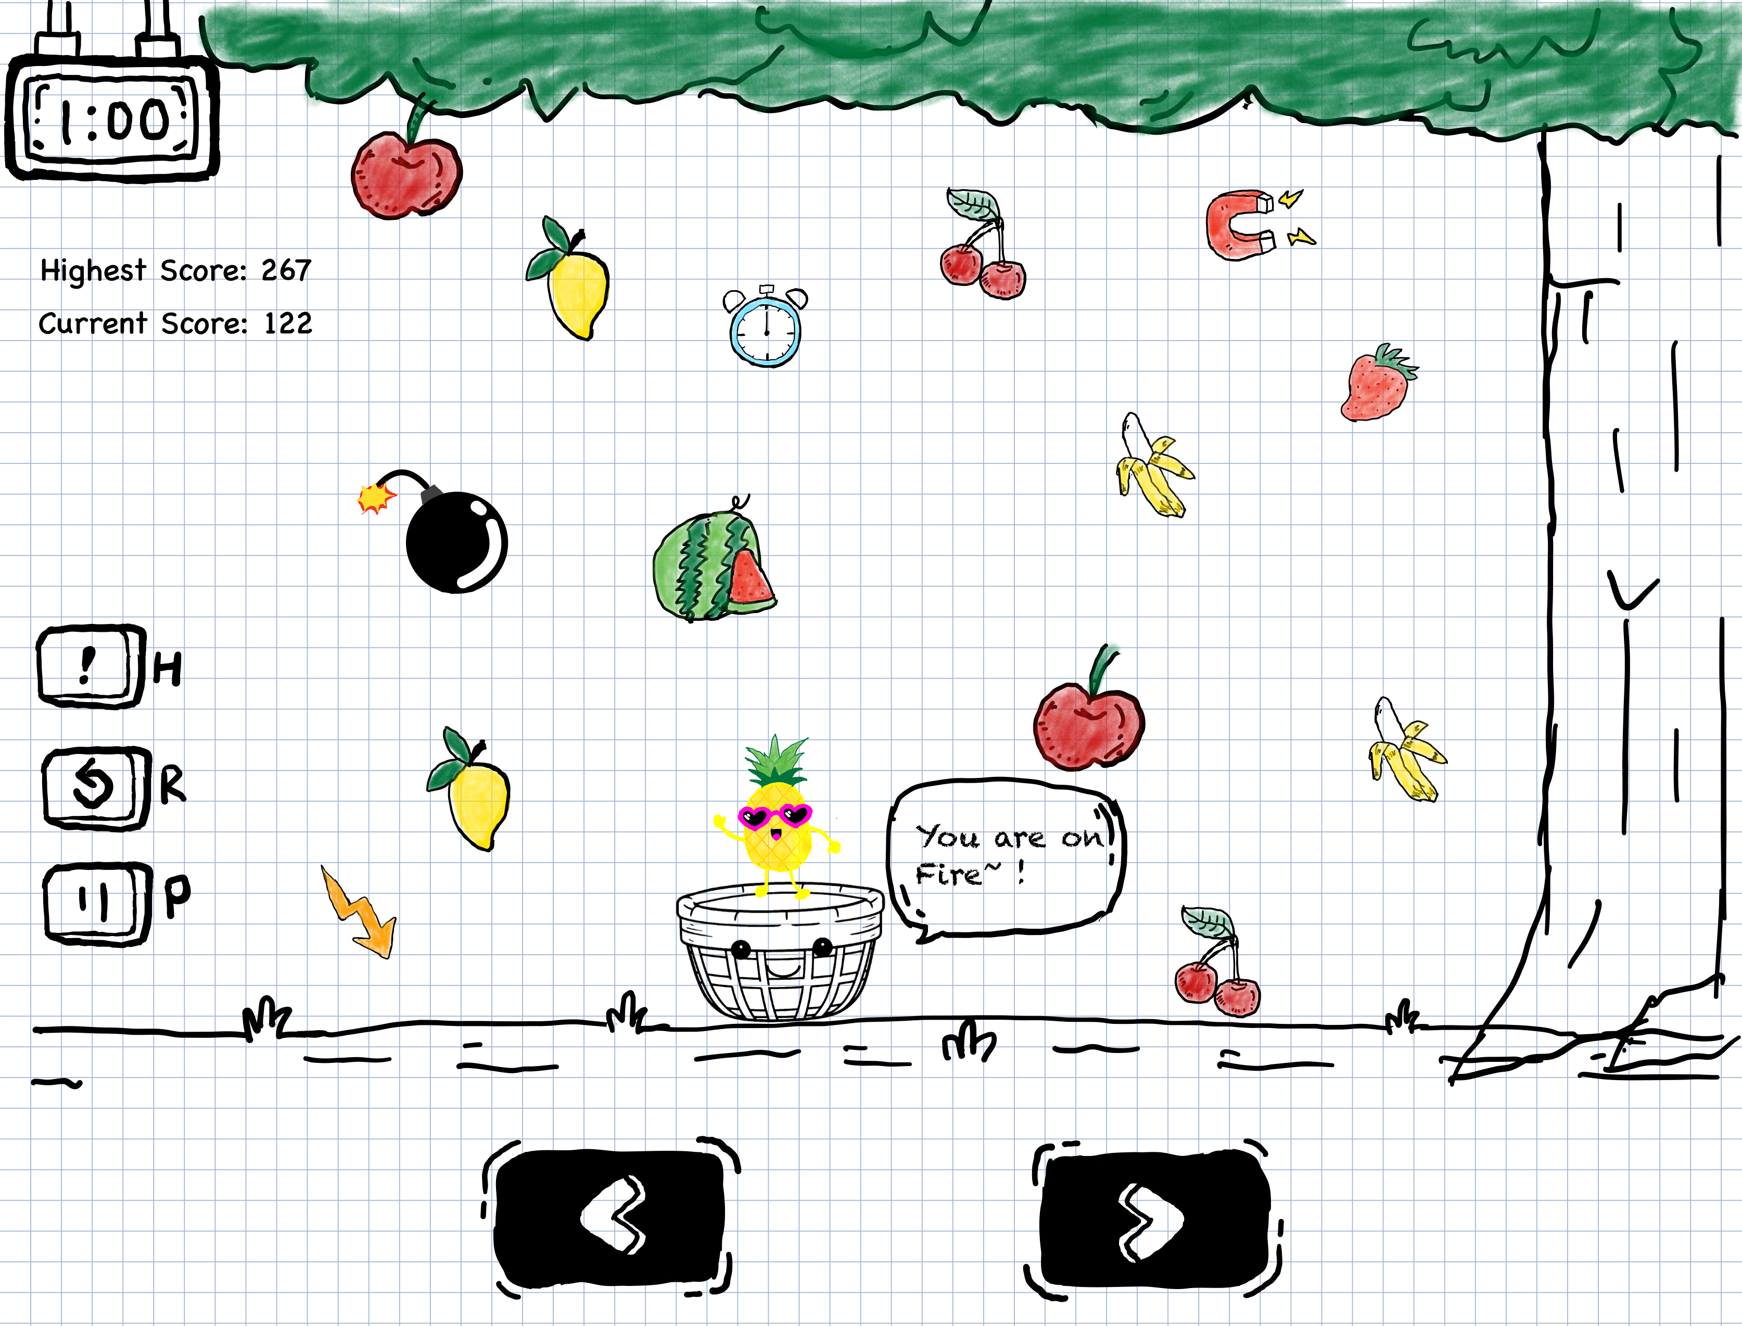
Gameplay Screen
Notes:
Player, Scores, Time, Meun,

Slide 7
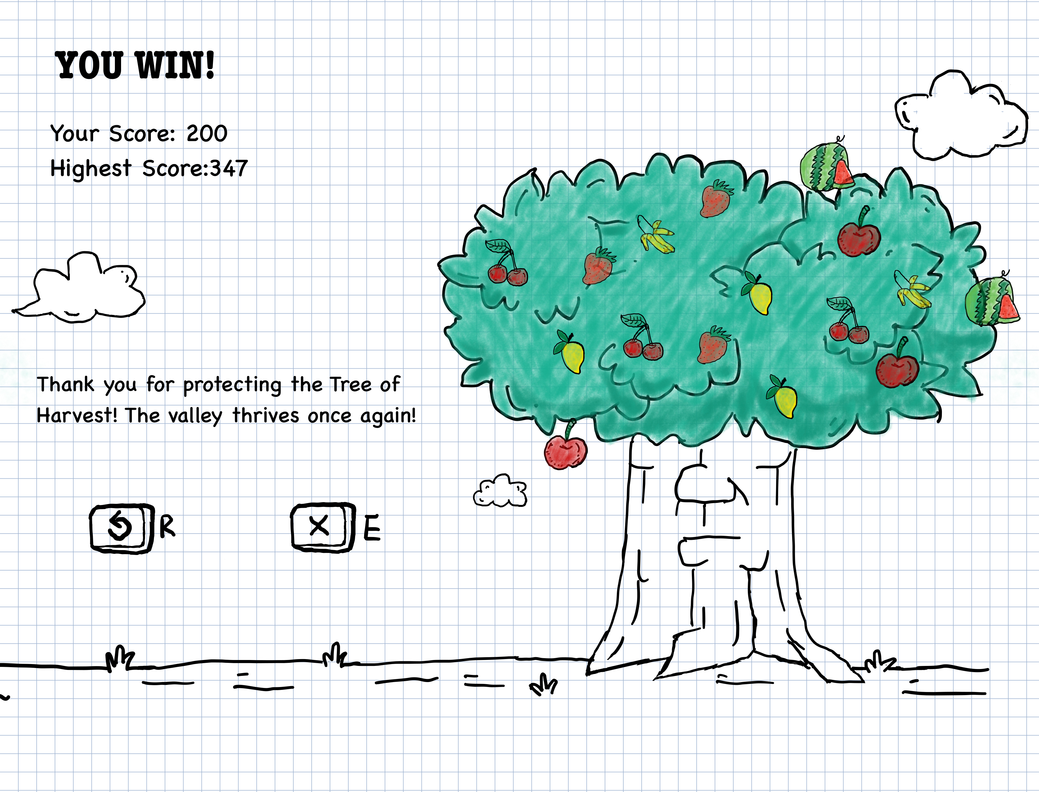
Victory Screen
Notes:
Win status, score, replay or exit

Slide 8
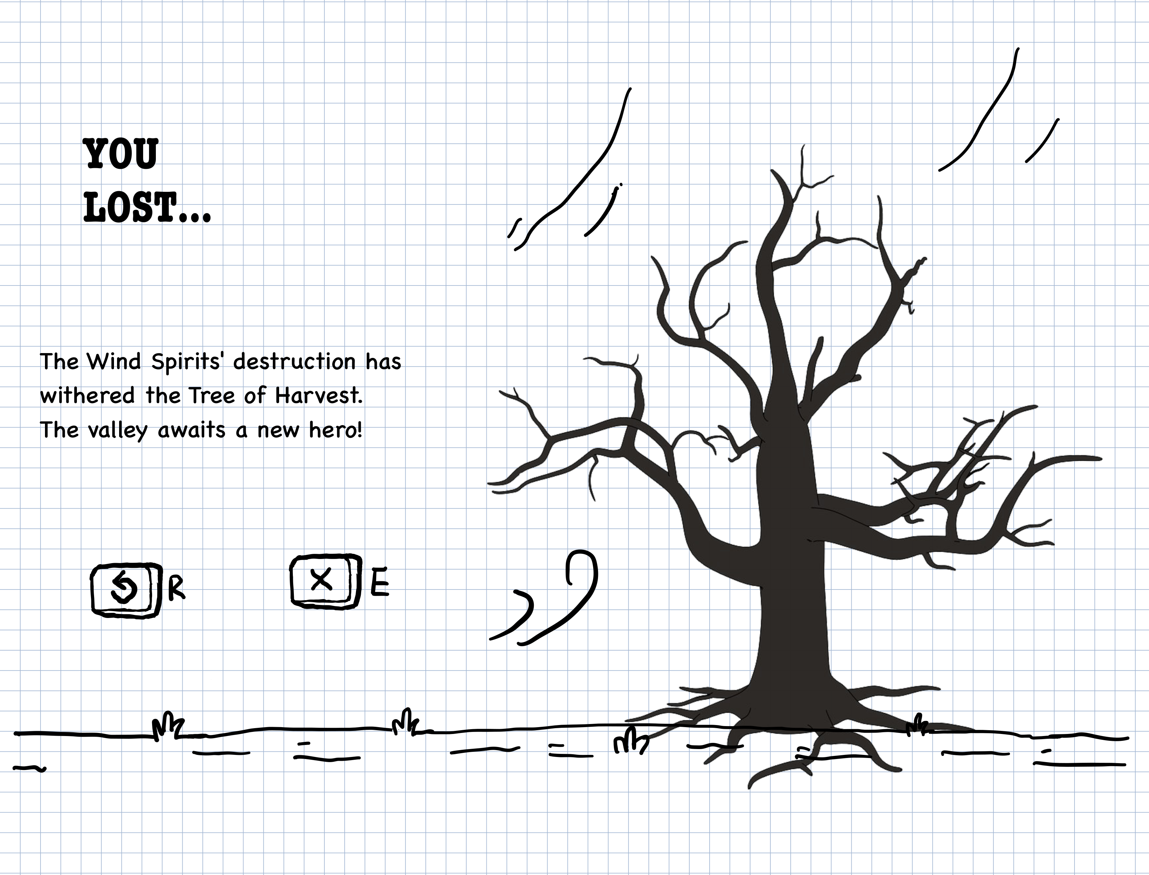
Failure Screen
Pending...
Notes:
loose status, replay or exit

Slide 9
Main Functions
03

Slide 10
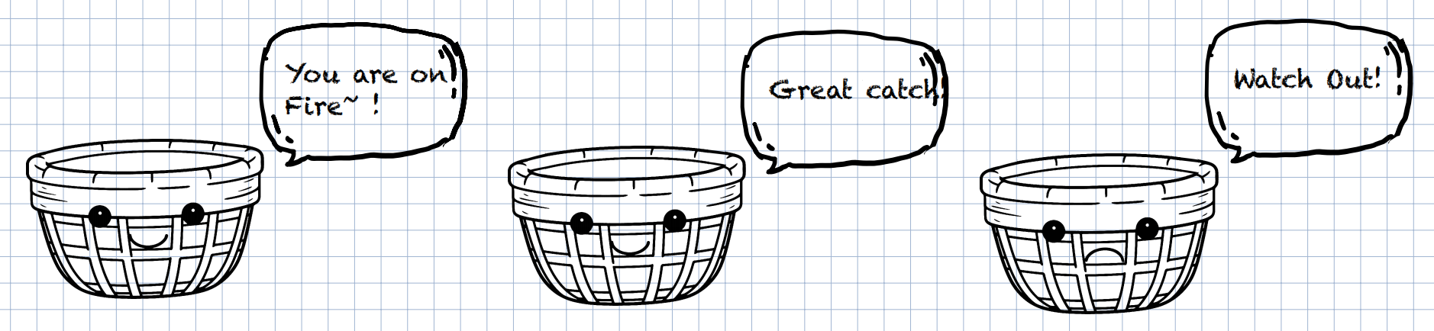
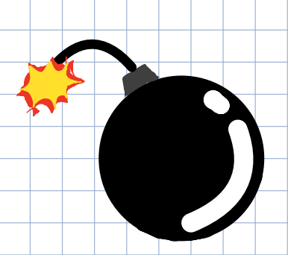
3.1 Player movement and Collision
Player Controls: Use left/right keys to move the basket.
Player Collision: with fruits; with bombs; with power ups.

Slide 11
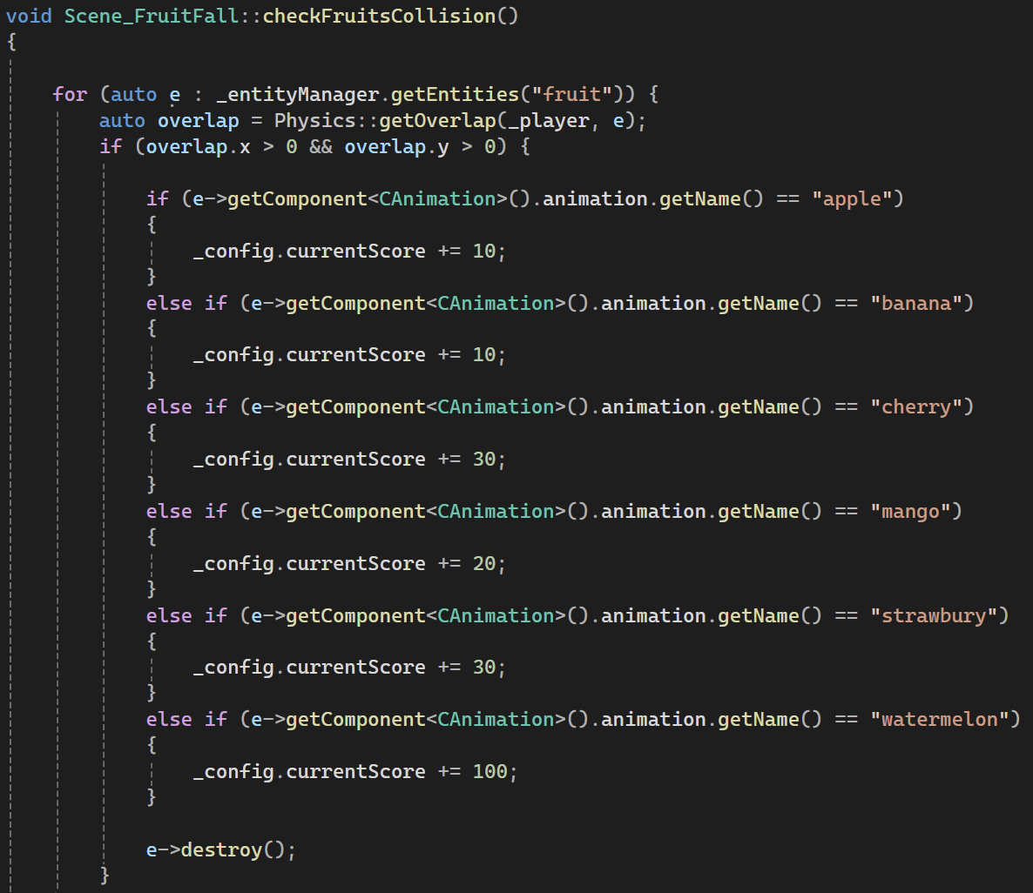
Player and Fruits
Collision / Scoring
Notes:
loose status, replay or exit

Slide 12
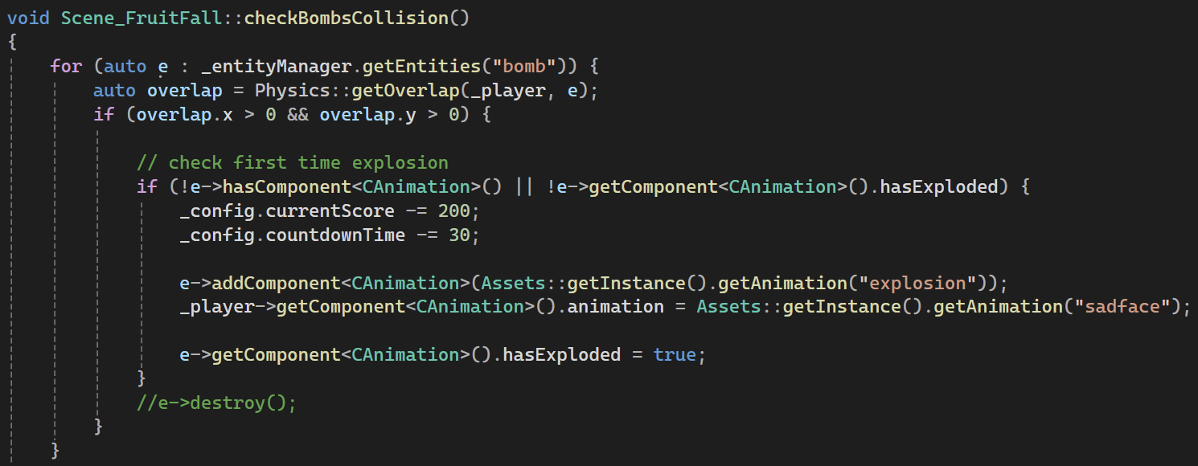
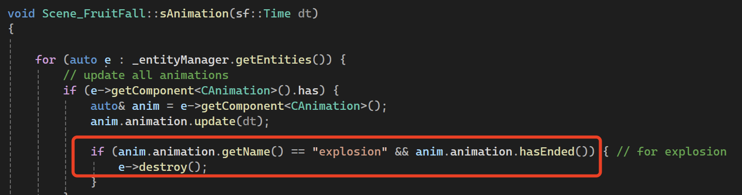
Player and Bombs
Collision
Notes:
loose status, replay or exit

Slide 13
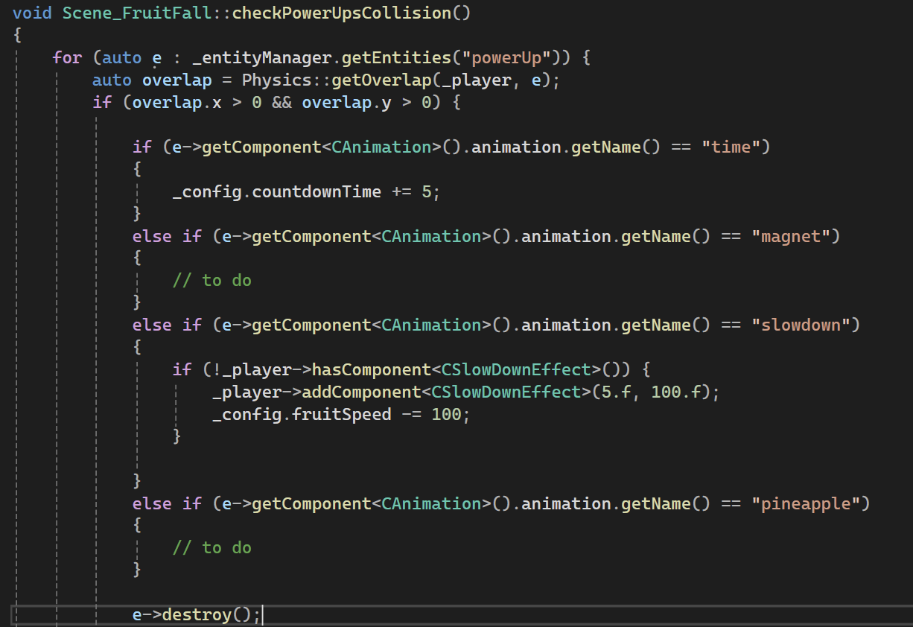
Player and Powerups
Collision
Notes:
loose status, replay or exit

Slide 14
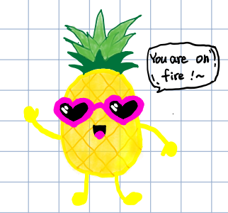
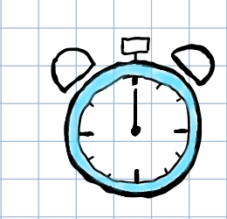
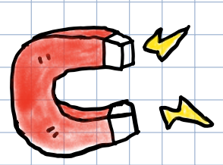
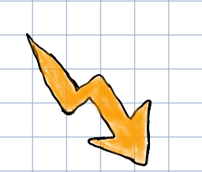
Power-Ups:
Time Extension: +5 seconds to the game timer.
Magnet: Attracts all fruits for 5 seconds.
Ice: Freezes bombs for 5 seconds.
Slow Motion: Slows object speed.
Golden Fruit: Doubles score.
Fruit Frenzy: Triggers a bomb-free fruit rain.

Slide 15
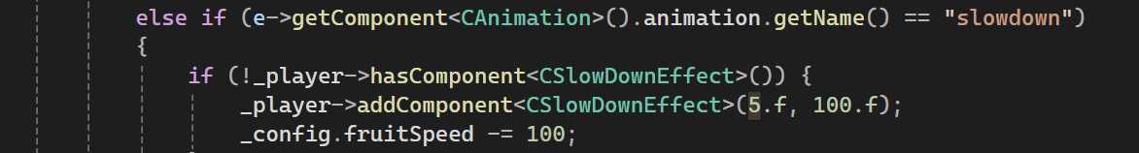
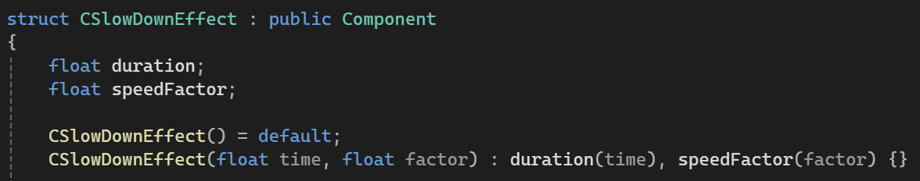
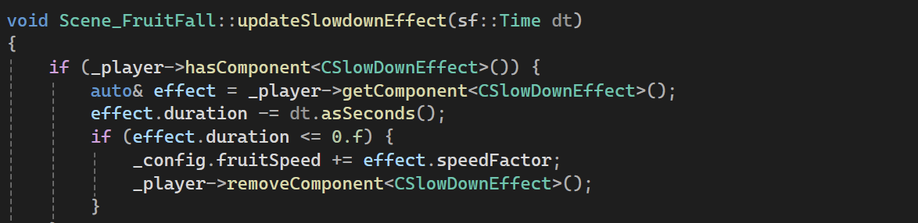
Slow down Effect
Notes:
loose status, replay or exit

Slide 16
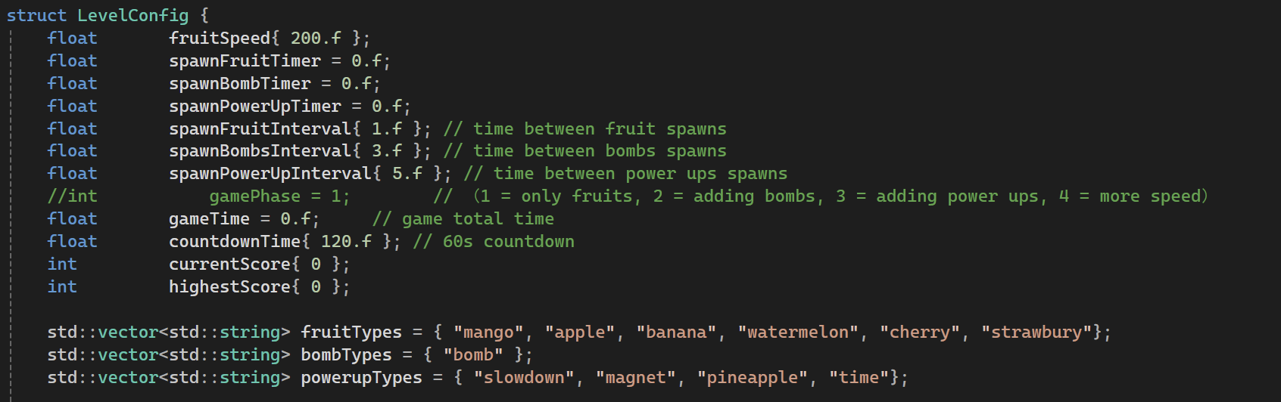
3.2 Spawn fruits, bombs, powerups
Entities:
Fruits: More than one kind, randomly spawn at random x position.
Bombs: One kind.
PowerUps: More than one kind, randomly spawn at random x position.

Slide 17
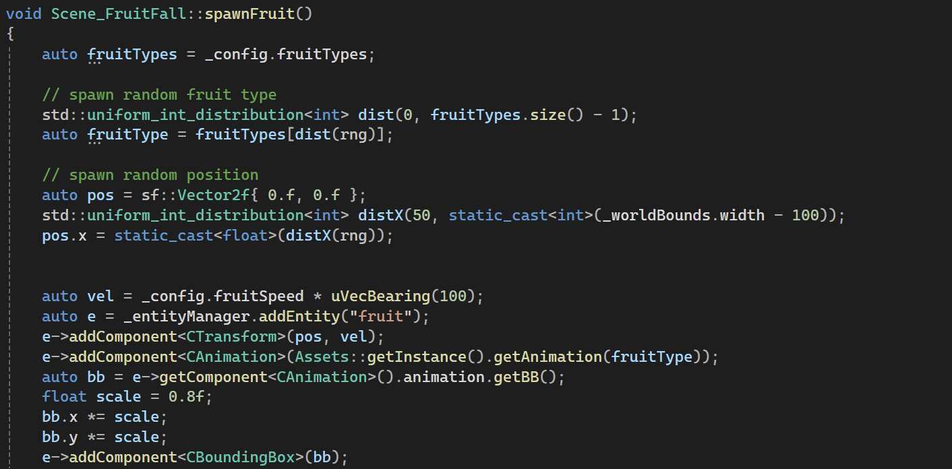
Spawn Fruits
Notes:
loose status, replay or exit

Slide 18
3.3 Progression
Game Progression:
0–5 seconds: A few fruits fall with no bombs.
5–10s: A few bombs are introduced, and the fruit speed is moderate.
After 10s: The falling speed increases slightly.
After 15s: Random power-ups start to appear.
After 30s: The falling speed increases further.
40–50s: Peak intensity—fruits and bombs fall at the fastest speed and in the highest quantities.
50s to end: The game slows down, with a normal quantity and speed of fruits and bombs for a smoother conclusion.
The ratio of fruits and bombs：
Early Stage: 90% fruits, 10% bombs.
Middle Stage: 70% fruits, 30% bombs.
Later Stage: 60% fruits, 40% bombs for added challenge.

Slide 19
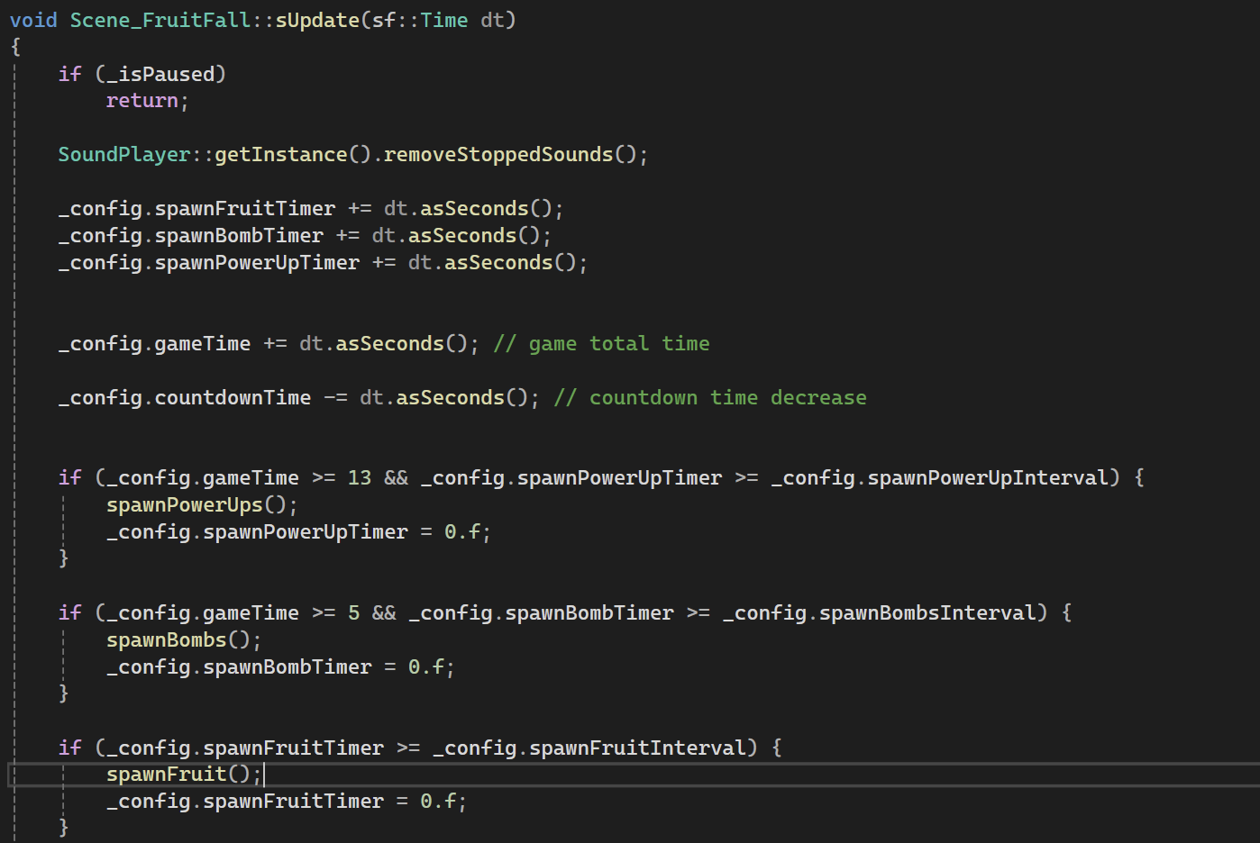
Update Game Progression
Notes:
loose status, replay or exit

Slide 20
Future Plan
04

Slide 21
4.1 Add Animation
Basket Animation:
Spawn status & static status
Move to the right
Half-transparent, allow fruits to fall inside
Character & Scene Animation:
Clouds move
Devil’s tail moves, fork moves up & down
Angel’s ring floats up & down

Slide 22
4.2
Improve User Experience
Fruits falling need gravity effect
When getting time extension, show +5s on screen, and countdown timer becomes bigger
Performance Issues
Game becomes laggy in late stage
Need to optimize frame rate & memory usage

Slide 23
4.3 Pending & Bugs
Fix & Improve Features
Magnet attracts all fruits for 5 seconds
Catching pineapple triggers “Fruit Fall Frenzy” (many fruits drop)
Phase 3: More fruits & faster speed
Game Over screen: Highest score, current score, restart & quit buttons
If catching a bomb, cooldown for 2 seconds, cannot move

Slide 24
THANK YOU
Ariel Zhao Liu

